Slide 1



PROMPT ENGINEERING
DAY - 3

Slide 2
Objective
Advanced Prompting Techniques

Slide 3
Topics Covered
Chain of thought prompting(guided reasoning)
Step-by-step instructions
Prompt Chaining(multi-step workflows)
Controlling ,tone,style and persona

Slide 4
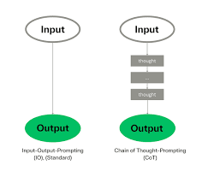
Chain of Thought Prompting
Improving reasoning accuracy by guiding Intermediate thinking steps

Slide 5
Introduction
Why chain-of-thought Works
Core Idea
Chain-of-Thought Flow(ASCII)
Implicit vs Explicit Reasoning
Direct Answer vs Chain-of-Thought
When to use Chain-of-Thought-prompting
Common Mistakes

Slide 6
Introduction
Chain- of-thought prompting is a techniue that encourages a language model to reason through a problem step by step before producing a final answer.
It is especially effective for tasks that require logic,math,analysis or multi-step reasoning
Instead of Jumping directly to the answer, the model is guided to internally organize the reasoning process.

Slide 7
Why chain of thought Works
Breaks complex problems into manageable steps
Reduces logical and arithmetic errors
Improves transperency of reasoning (at a high level)
Encourages structured problem solving
Performs better on reasoning heavy tasks

Slide 8
Core Idea
The prompt explicitly requests reasoning steps or structured analysis before the final answer.The model uses these steps to internally reason,even if only a summarized explanation is shown in the output

Slide 9
Chain - of-Thought Flow(ASCII)
Problem
Identify Relevant Information
Apply Logical Steps
Reach Conclusion
Final Answer

Slide 10
Basic Example
Question:
If a Book costs $10 and you buy 3 books,how much do you pay?
Instruction:
Think through the problem step by step,then give the final answer.
This model uses intermediate reasoning to arrive at the correct result

Slide 11
Implicit vs Explicit Reasoning
Approach | Description | When to use
Implicit | Model reasons internally | Production Systems
Explicit | Model Shows reasoning steps | Learning and debugging

Slide 12
Direct Answer vs Chain-of-Thought
Direct Prompt:
What is 27 *14?
Chain-of-Thought Prompt?
Calculate 27*14
Break the calculation into clear logical steps and then provide the final answer.

Slide 13



When to use Chain-of-Thought Prompting
Mathematical reasoning
Logical problem solving
Decision analysis
Multi-step explanations
Complex comparisions

Slide 14
Common Mistakes
Using chain-of-thought for trivial tasks
Requesting overly verbose reasoning
Confusing explanation with correctness
Not constraining final output
Assuming reasoning guarantees accuracy

Slide 15

Reasoning & Problem Solving Prompts

Slide 16
Step- By-Step reasoning Prompts
Introduction
Step-by-Step reasoning prompts are designed to encourage an LLM to break down a problem into logical steps before producing a final answer

Slide 17
Core Idea
Explicitly ask for reasoning steps
Force structured thinking
Reduce guessing or shortcut answers
Expose intermediate logic
Increase trust in the output

Slide 18

Why step-by-step Reasoning Works
Large-Language Models perform better when guided to reason incrementally rather than jumping directly to conclusions.
Step-By-Step prompts reduce reasoning,errors by encouraging deliberate,seuential thinking.

Slide 19
Reasoning Flow(ASCII)
Problem
Understand Inputs
Apply Rules/Logic
Intermediate Conclusions
Final Answer

Slide 20
Basic Prompt Pattern
Solve the following problem step-by-step
Explain your reasoning clearly before giving the final answer

Slide 21
Simple Example
Question:
If a shirt costs 500 and is discounted by 20%,what is the final price?
Prompt:
Calculate the answer step by step and show all reasoning

Slide 22
Common use cases
Mathematical problem solving
Logical puzzles
Algorithm explanation
Debugging code logic
Decision-making analysis

Slide 23
Direct Answer vs Step-By-Step
Aspect | Direct Answer | Step-by-Step
Accuracy | Lower | Higher
Transperancy | Low | High
Error Detection | Difficult | Easier
Explainability | Poor | Excellent

Slide 24
Common Mistakes
Using step-by-step for trivial questions
Not defining what step-by-step means
Allowing excessively long reasoning
Forgetting to ask for a final answer

Slide 25

PROMPT CHAINING (Multi-step-work-flows)

Slide 26

Prompt Chaining
Prompt chaining is an automation technique where multiple prompts are linked together.The output of on prompt becoomes the input for the next, creating a structured workflow that can handle complex tasks step by step

Slide 27
Why Prompt Chaining Matters
Automates multi-step tasks without manual intervention.
Ensures Logical processes by feeding outputs into subsequent prompts
Improves efficiency and consistency in workflows
Supports scalability for repetitive or structured processes.

Slide 28
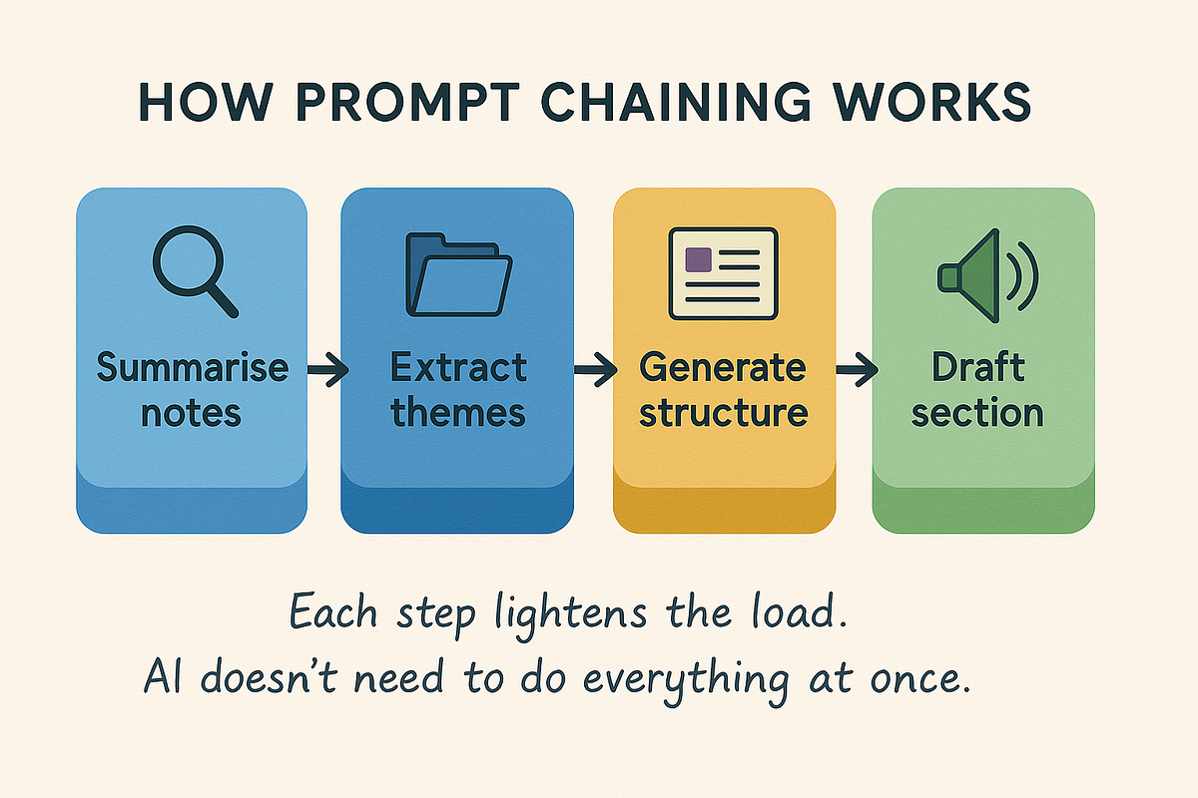
How It Works
You design a chain of prompts where each stage has a clear purpose.The agent executes the first prompt ,then uses its output as the input for the next prompt,continuing until the final result is produced

Slide 29
Example Workflow
Task: Automate blog post creation
Step 1 Prompt:”Generate 5 blog title ideas about eco-friendly travel.”
Step 2 Prompt:”Pick the best titile and draft an outline
Step 3 Prompt:”Expand the outline into a 500 word article”
Step 4 Prompt:”Summarize the article into a 3-bullet social media post.”
Expected Outcome:
A complete blog post,with supporting social media content, created through chained prompts.

Slide 30
Tip : Clearly define outputs at each stage so they can be reused effectively in the next prompt
Summary
Prompt chaining enables automation by linking multiple prompts into a structured workflow.It is ideal for tasks,like content creation,research and reporting where outputs build progressively.

Slide 31
Mutli - Step Workflows
Multi-step workflows in prompt chaining involve breaking a complex task into a sequence smaller,manageable steps,where the output of onreprompt becomes the input for the next.
Key features
Each step builds on the previous output
Ensures better quality and consistency
Easy to debug and refine individual steps
Example
Generate topic outline
Expand each point

Slide 32
Persona and Expert Simulation
Simulating specific,mindsets,expertise levels,and professional behaviour in LLM
Definition
Persona and expert simulation is a prompt engineering technique where you instruct a language model to behave as a specific type of person,proffessional,or domain expert.
This technique influences reasoning depth,vocabulary,assumptions,tone,and decision making patterns

Slide 33
Persona vs Expert Simulation
Aspect | Persona | Expert Simulation
Focus | Perspective and mindset | Depth of Knowledge
Examples | Beginner,manager | Senior engineer,lawyer
Languages | Audience-aligned | Domain-specific
Primary Goal | Relatability | Accuracy and rigor

Slide 34
Why Persona and Expert Simulation Matters
Improves relevance and clarity
Aligns explanantions with audience skill level
Reduces generic responses
Enhances realism in simulations
Makes outputs more actionable

Slide 35
Common Personas
Beginner learner
Intermediate practitioner
Non-technical stakeholder
Technical Interviewer
Product Manager

Slide 36
Common Expert Roles
Senior software engineer
Prompt engineering specialist
Data scientist
Security analyst
Technical writer

Slide 37
Basic Persona Example
You are a beginner-friendly instructor.
Explain prompt engineering using simple language and analogies
Expert Simulation Example
You are a senior prompt engineering expert Explain few-shot prompting including limitations and best practices.

Slide 38
Activity:Build a Multi-Step Prompt
Objective: Learn to design a structured prompt using
Analyze--->Summarize--->Recommend
Task:
Choose any topic (e.g, AI in education,online learning,social media)
Create your own multi-step prompt following the structure

Slide 39
Prompt Structure
Analyze: Identify key points or issues
Summarize:Present main ideas briefly
Recommend:Suggest solutions or improvements
Example:
“Analyze the impact of online learning on students,summarize the key points in 5 bullet points and recommended 3 ways to improve engagement”

Slide 40


